Slide 1



Lecture 1b
The Perceptron
Master in Big Data Solutions 2020-2021 - Artificial Intelligence
Xavier Giró
xavier.giro@bts.tech

Slide 2




Acknowledgements
Santiago Pascual
Kevin McGuinness
kevin.mcguinness@dcu.ie
Research Fellow
Insight Centre for Data Analytics
Dublin City University

Slide 3
Outline
From Linear Regression to Binary Classification
The Perceptron
Logistic Regression
Decision Threshold & Metrics
Other Activation functions
Implementation with PyTorch

Slide 4
Outline
From Linear Regression to Binary Classification
The Perceptron
Logistic Regression
Decision Threshold & Metrics
Other Activation functions
Implementation with PyTorch

Slide 5





From Regression to Classification
Consider a manifold of RGB images of dogs and cats, all images of MxN pixels.
Question: What is the dimensionality of the space in which these images exist ?

Slide 6
From Regression to Classification
Consider a manifold of RGB images of dogs and cats, all images of MxN pixels.
Question: What is the dimensionality of the space in which these images exist ?
Each image is a point in an M x N x 3 (RGB channels) dimensional space.

Slide 7
From Regression to Classification
Question: Would it be possible to project all images in a 1-D space where the cats and dogs are linearly separable ?
1-D space
x
?
MxNx3-D space

Slide 8
From Regression to Classification
Question: Would it be possible to project all images in a 1-D space where the cats and dogs are linearly separable ?
1-D space
x
Deep Neural Networks
MxNx3-D space

Slide 9
From Regression to Classification
Question: Could we map all cats to negative values and all dogs to positive values ?
0
1-D space
x
?
0
1-D space
x

Slide 10
From Regression to Classification
Question: Could we map all cats to negative values and all dogs to positive values ?
0
1-D space
a
Linear regression
w·x+b
0
1-D space
x

Slide 11
From Regression to Classification
Question: How could we numerically encode the two classes as 0 (cats) and 1 (dogs) ?
y=u(a)
1
1-D space
a
0

Slide 12
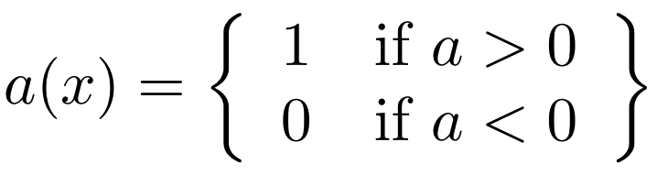
From Regression to Classification
Question: How could we numerically encode the two classes as 0 (cats) and 1 (dogs) ?
The heaviside (or step) function could generate the mapping.
y=u(a)
1
1-D space
a
0

Slide 13
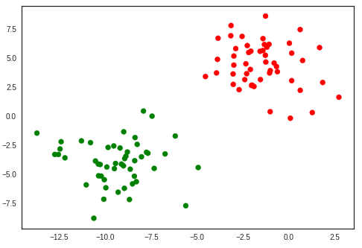


From Regression to Classification
The same reasoning can be applied to 2-D (or N-D) representations:
2-D space
x₂
x₁

Slide 14
Outline
From Linear Regression to Binary Classification
The Perceptron
Logistic Regression
Decision Threshold & Metrics
Other Activation functions
Implementation with PyTorch

Slide 15
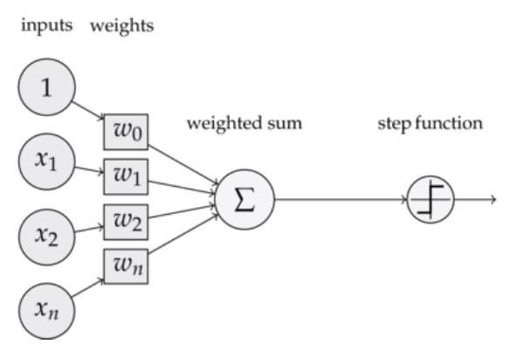
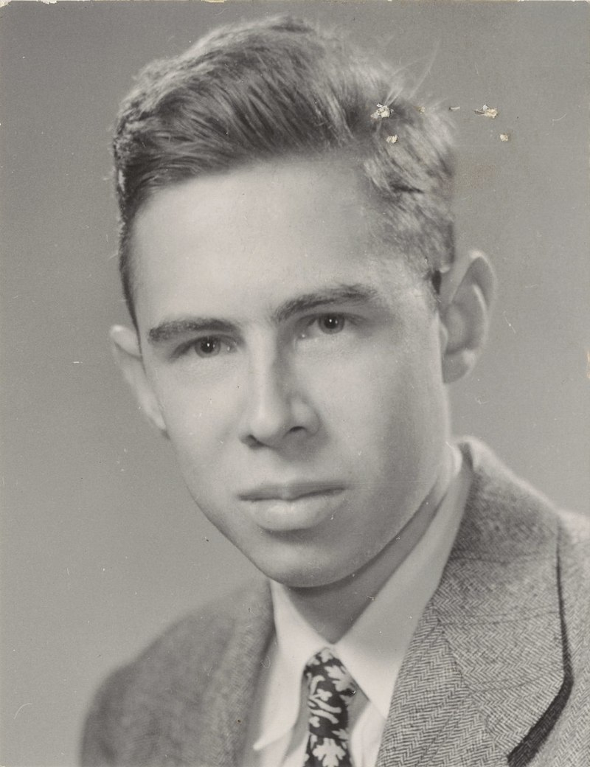
Single Neuron Model (Perceptron)
Rosenblatt, F. (1958). The perceptron: a probabilistic model for information storage and organization in the brain. Psychological review, 65(6), 386.

Slide 16
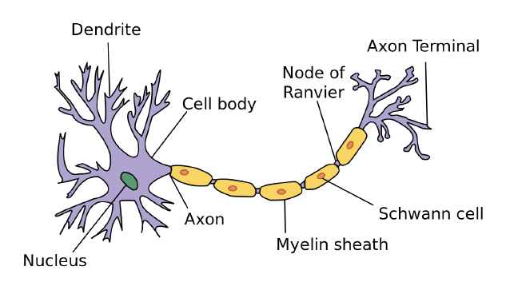
Single Neuron Model (Perceptron)
The Perceptron is seen as an analogy to a biological neuron because they fire an impulse once the sum of all inputs is over a threshold.
Rosenblatt, F. (1958). The perceptron: a probabilistic model for information storage and organization in the brain. Psychological review, 65(6), 386.

Slide 17
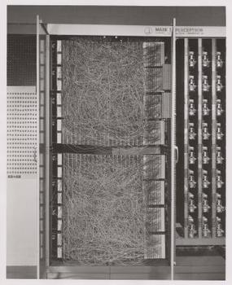
Single Neuron Model (Perceptron)
Mark I Perceptron machine: First implementation of the perceptron. Input: a camera with 20×20 cadmium sulfide photocells to capture a 400-pixel image.
Patch panel that set different combinations of input features.
Arrays of potentiometers that implemented the adaptive weights
Source: Bishop, Christopher M. (2006). Pattern Recognition and Machine Learning. Springer (via Wikipedia).

Slide 18
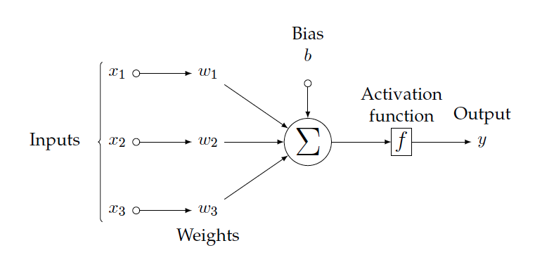
Single Neuron Model (Perceptron)

Slide 19
Single Neuron Model (Perceptron)
Weights and bias are the parameters that define the behavior. They must be estimated during training.

Slide 20
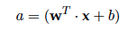
Single Neuron Model (Perceptron)
Input data x is linearly combined with the weights and bias of the perceptron.

Slide 21
Single Neuron Model (Perceptron)
A single perceptron can address for both regression or classification tasks, depending on the on the chosen activation function.

Slide 22
Outline
From Linear Regression to Binary Classification
The Perceptron
Logistic Regression
Decision Threshold & Metrics
Other Activation functions
Implementation with PyTorch

Slide 23

Logistic Regression
Unfortunately, the heaviside function is not suitable for training neural networks because its derivative is 0 (or does not exist). This prevents running the backpropagation algorithm which is commonly used to train NN (seen later).
y=u(a)
1
a
0

Slide 24
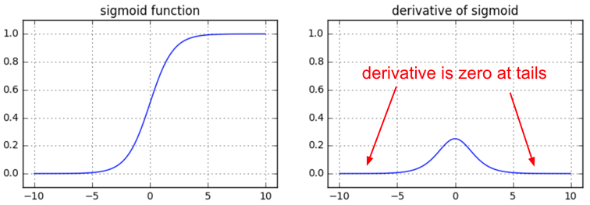
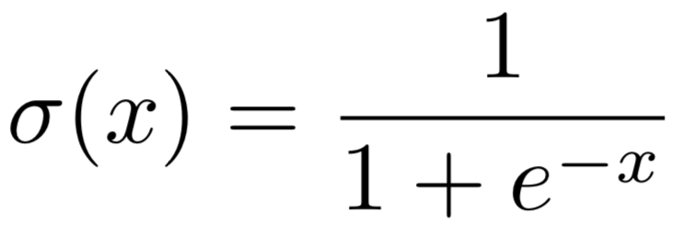
Logistic Regression
A differentiable approximation the heaviside function is the sigmoid function σ(x), also referred as logistic curve.
➝ 1
➝ 0
1-D space
Figure: Andrej Karpathy

Slide 25
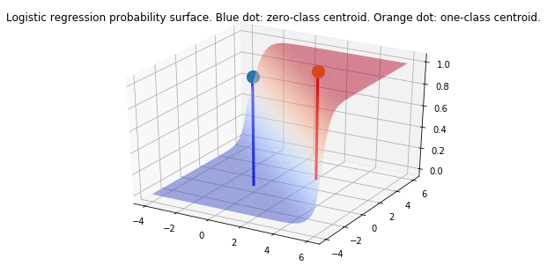
Logistic Regression
The same reasoning can be applied to 2-D (or N-D) representations:
2-D space
Figure: Santiago Pascual (UPC 2019)

Slide 26
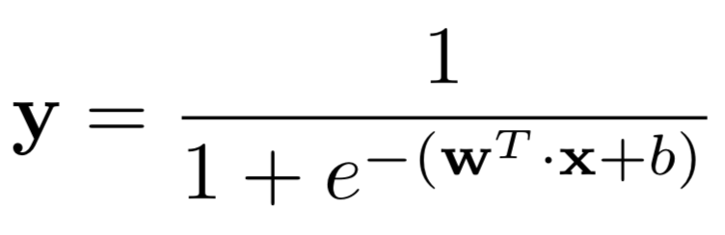
Logistic Regression
The perceptron can address binary classification problems when f(a)=σ(a). [sigmoid]
σ
Logits

Slide 27
Outline
From Linear Regression to Binary Classification
The Perceptron
Logistic Regression
Decision Threshold & Metrics
Other Activation functions
Implementation with PyTorch

Slide 28
Decision Threshold
Setting a decision threshold at the output of a logistic regressor allows solving classification problems between two classes (binary):
y > ૪ →
y < ૪ →

Slide 29
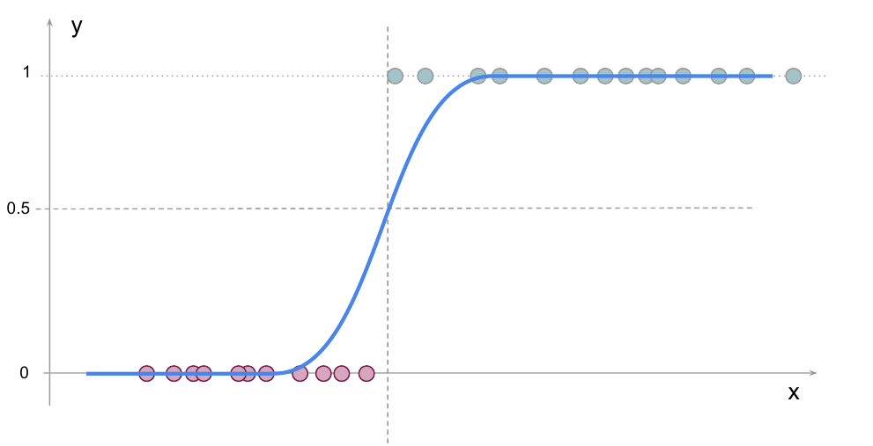
Decision Threshold
For classification, regressed values should be collapsed into 0 and 1 to quantize the confidence of the predictions (“probabilities”).
Threshold (૪)

Slide 30
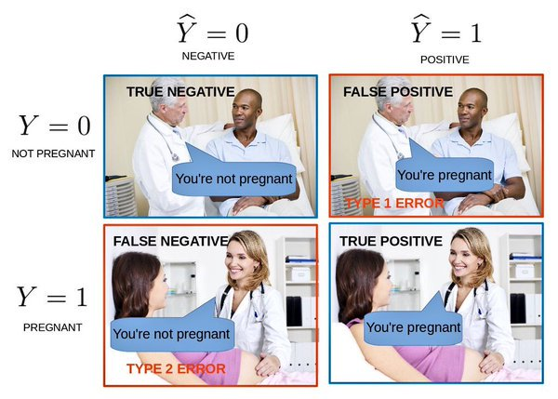
Metrics: Confusion matrix
Confusion matrices provide a by-class comparison between the results of the automatic predictions with ground truth annotations.
 |  | Prediction (y^)
 |  | Negative | Positive
Ground Truth (y) | Negative | True negative (TN) | False positive (FP)
 | Positive | False negative (FN) | True positive (TP)

Slide 31
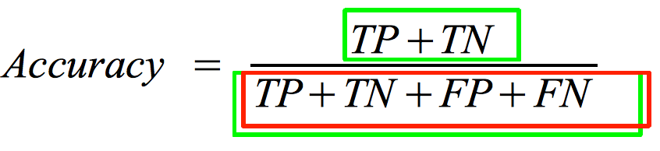
Metrics: Accuracy
The “accuracy” measures the proportion of correct classifications, not distinguishing between classes.
 |  | Prediction (y^)
 |  | Negative | Positive
Ground Truth (y) | Negative | True negative (TN) | False positive (FP)
 | Positive | False negative (FN) | True positive (TP)

Slide 32

Metrics: Precision & Recall
Given a reference class, its Precision (P) and Recall (R) are complementary measures of quality.
"Precisionrecall" by Walber - Own work. Licensed under Creative Commons Attribution-Share Alike 4.0 via Wikimedia Commons - http://commons.wikimedia.org/wiki/File:Precisionrecall.svg#mediaviewer/File:Precisionrecall.svg

Slide 33
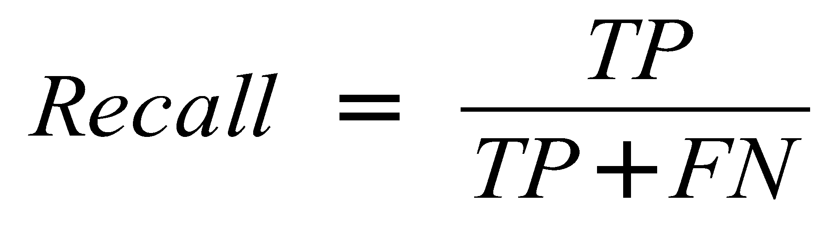
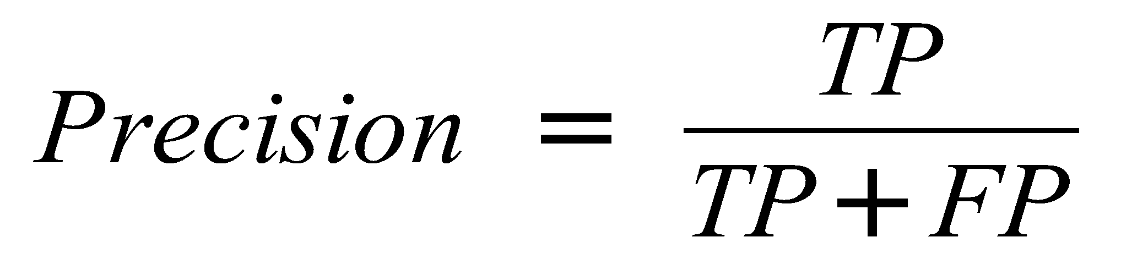
Metrics: Precision & Recall
Example: Relevant class is “Positive” in a binary classifier.
 |  | Prediction (y^)
 |  | Negative | Positive
Ground Truth (y) | Negative | True negative (TN) | False positive (FP)
 | Positive | False negative (FN) | True positive (TP)

Slide 34
Metrics: Precision & Recall
Adjusting the decision threshold allows defining whether false positives or false negatives are more critical for our application.
High precision & low recall for class green
Low precision & high recall for class green

Slide 35
Outline
From Linear Regression to Binary Classification
The Perceptron
Logistic Regression
Decision Threshold & Metrics
Activation functions
Implementation with PyTorch

Slide 36
Activation Functions
The activation function may introduce other non-linearities.

Slide 37
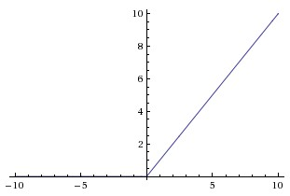
Activation Functions
Desirable properties
Mostly smooth, continuous, differentiable
Fairly linear
Common nonlinearities
Sigmoid
Tanh
ReLU = max(0, x)
Rectified Linear Unit (ReLU)
Why do we need non-linearities ?
If we only use linear layers we are only able to learn linear transformations of our input.

Slide 38
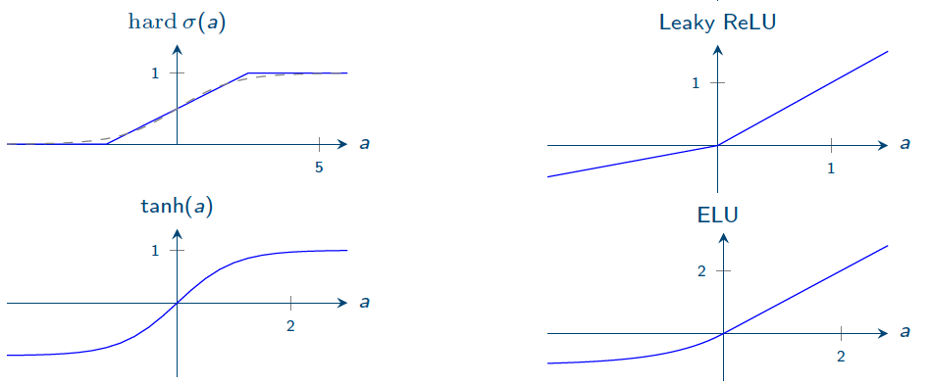
Activation Functions
Other popular activation functions:

Slide 39
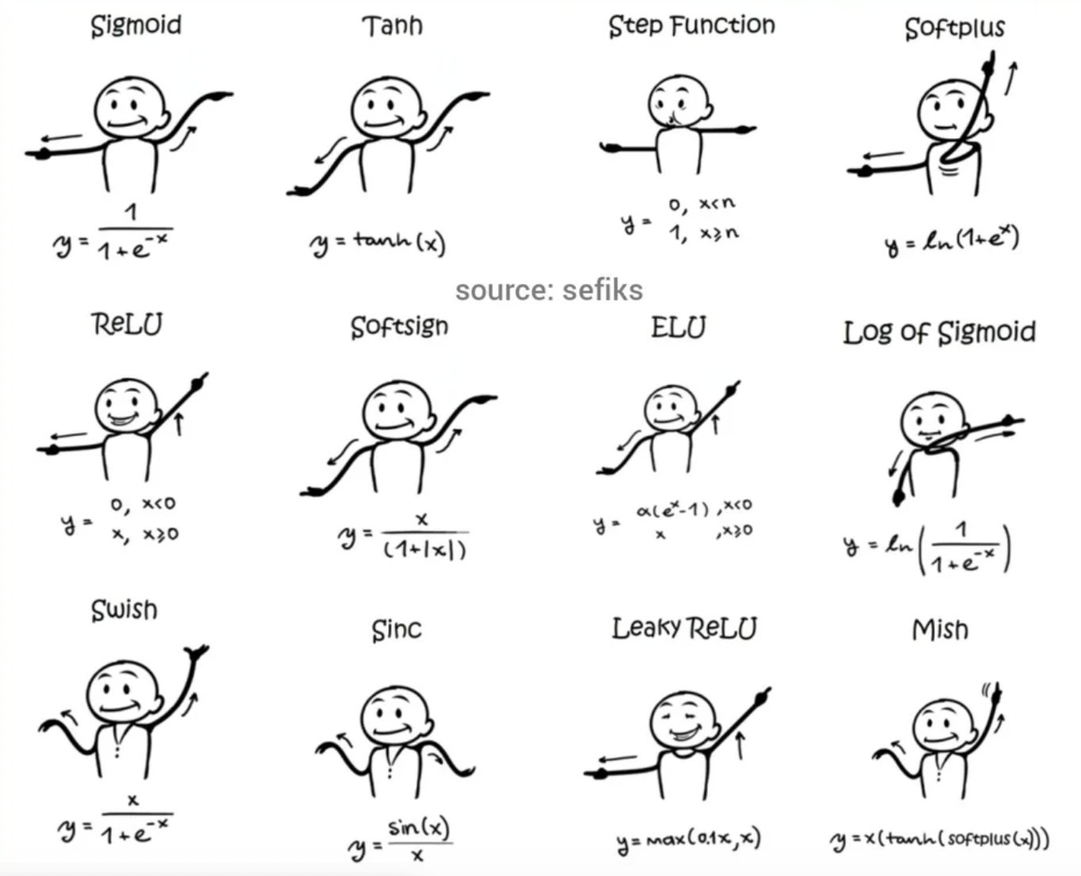
Activation Functions

Slide 40
Outline
From Linear Regression to Binary Classification
The Perceptron
Logistic Regression
Decision Threshold & Metrics
Other Activation functions
Implementation with PyTorch

Slide 41

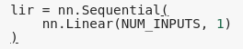
Linear Regression
1
x₁
b
w₁
y = {-∞, +∞}
x₂
w₂
x₃
w₃

Slide 42
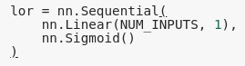
Logistic Regression
1
x₁
b
w₁
σ
y = {0, 1}
x₂
w₂
x₃
w₃

Slide 43
Outline
From Linear Regression to Binary Classification
The Perceptron
Logistic Regression
Decision Threshold & Metrics
Other Activation functions
Implementation with PyTorch

Slide 44


